Slide 1
GESTURE RECOGNITION MOBILE DISPENSER ROBOT
INTERNAL PROJECT SUPERVISOR
NAME: DR.D.JESSINTHA
DESIGNATION: ASSISTANT PROFESSOR(ECE DEPT)
BY:
ABISHEK S
ADITYAA V
ANURUTH SREE V

Slide 2
OUTLINE
OBJECTIVES
INTRODUCTION
LITERATURE SURVEY
BLOCK DIAGRAM
PROPOSED METHODOLOGY
HARDWARE REQUIREMENTS
SOFTWARE REQUIREMENTS
WORK DONE
DEMONSTRATION
CONCLUSION
REFERENCES

Slide 3
OBJECTIVES
This paper instantiates our design of a user friendly controlled path mobile dispenser robot that can assist small scale restaurants, stalls, Hospitals, Domestic purposes, Public domains such as Airports, Bus terminals and cafeteria with the help of gesture recognition which contributes minimum tangency interaction with customers reducing labor cost and improving quality of service.

Slide 4
INTRODUCTION
Robots are able to carry out every work more effectively and efficiently than a man can do. Hence one of such application of robot could be SERVING ROBOT. There are many areas of research that could be done for a serving robot. The branch of robotics that plays such a vital role is called “social robotics” . Social robots in today’s scenario are now communicating with human, interacting and relating to society in all aspect and are capable of understanding social terms . Due to the modernization in robotic technologies, many new designs and mechanisms are being implemented which are able to read human thoughts and understand actions. There is an ever rising trend in using robots in restaurants for automation . In this paper we demonstrate a prototype of Autonomous Mobile Dispenser Serving Robot for customer and personal service purposes. The implementation of the robot is proposed here.

Slide 5
LITERATURE SURVEY
S.NO | JOURNAL DETAILS | TECHNIQUES USED | INFERENCE
1. | SMART FOOD SERVING ROBOT IN RESTAURANT(March 2019) | Line follower, Obstacle detector, Hand movement, Wireless technology, Position detector | Learnt to construct a solid base with proper mechanism and made it work.
2. | DEVELOPING A MULTIPLE-ANGLE HAND-GESTURE-RECOGNITION SYSTEM (November 2007) | Gesture Recognition
3. | PERISTALTIC PUMPS (January 2015) | Peristalsis and pressure pumps | Learnt how to work with DC pumps.
4. | WAVING REAL-HAND GESTURES (April 2007) | Gesture Recognition

Slide 6
LITERATURE SURVEY
S.NO | JOURNAL DETAILS | TECHNIQUES USED | INFERENCE
5. | COLOR RECOGNITION ROBOT (May 2011) | Color recognition | Learnt how to interface a color sensor and operate it.
6. | DESIGN AND FABRICATION OF PICK AND PLACE ROBOTIC (August 2020) | Robot arm fabrication | Learnt which materials are compatible for construction and fabrication of a robotic arm.

Slide 7
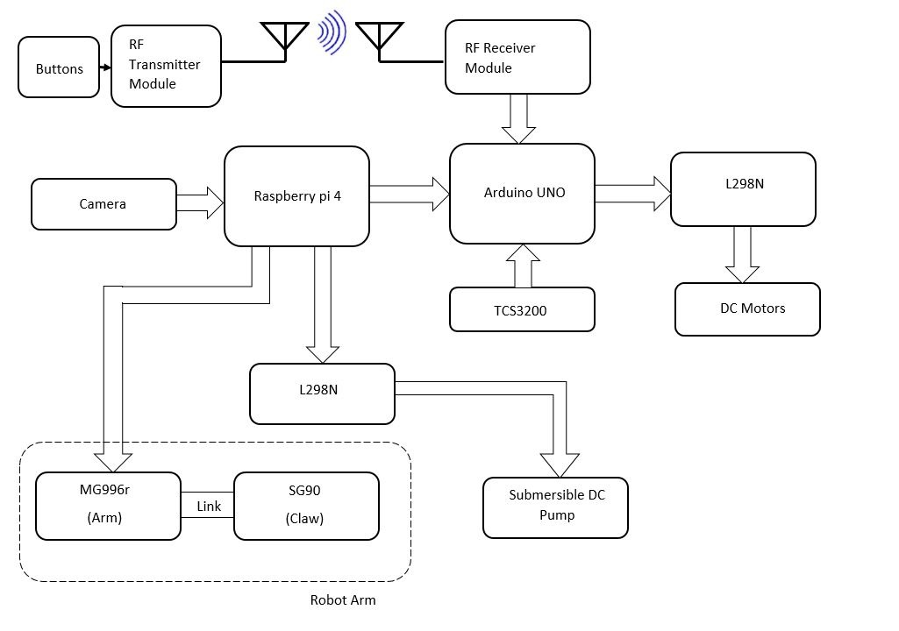
BLOCK DIAGRAM
MOBILE DISPENSER ROBOT

Slide 8
PROPOSED METHODOLOGY
Robot is summoned via 27MHz RF Transmitter module using button by the customer.
Robot base receives the message and sets up its path using color sensor (TCS3200) with respect to the message.
Customer provides input as gestures.
Gesture is processed by Raspberry Pi and sent as input to Arduino.
Arduino controls the movement of Robotic arm using servo motors (SG90 and MG996r).
Robotic arm picks and places the cup at a desired position below the dispenser.
Robot returns to origin after completing the fore mentioned events and waits for RF signals from next customer.

Slide 9
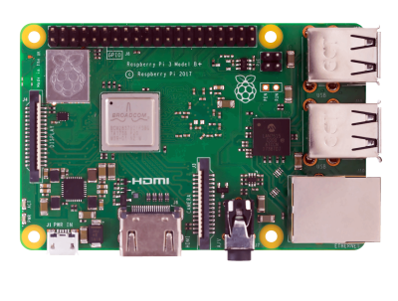
HARDWARE REQUIREMENTS
RASPBERRY PI 4:
Raspberry Pi 4 is a 1.5 GHz 64-bit quad core ARM CORTEX A72 processor.
It is embedded by an on-board 802.11ac Wi-Fi, Bluetooth, full gigabit Ethernet, two USB2.0 ports, two USB 3.0 ports, and dual-monitor support via a pair of micro HDMI (HDMI Type D) ports for up to 4K resolution.
The Pi 4 is also powered via a USB-C port, enabling additional power to be provided to downstream peripherals, when used with an appropriate PSU.

Slide 10
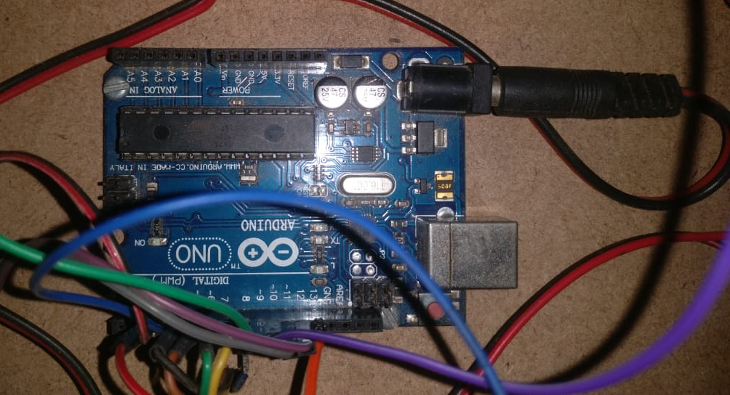
HARDWARE REQUIREMENTS
ARDUINO UNO:
The Arduino Uno is an open-source microcontroller board based on the Microchip ATmega328P microcontroller and developed by Arduino.cc.
The board is equipped with sets of digital and analog input/output (I/O) pins that may be interfaced to various expansion boards (shields) and other circuits. The board has 14 digital I/O pins (six capable of PWM output), 6 analog I/O pins, and is programmable with the Arduino IDE (Integrated Development Environment), via a type B USB cable.
It can be powered by the USB cable or by an external 9-volt battery, though it accepts voltages between 7 and 20 volts. It is similar to the Arduino Nano and Leonardo.
The hardware reference design is distributed under a Creative Commons Attribution Share-Alike 2.5 license and is available on the Arduino website.

Slide 11
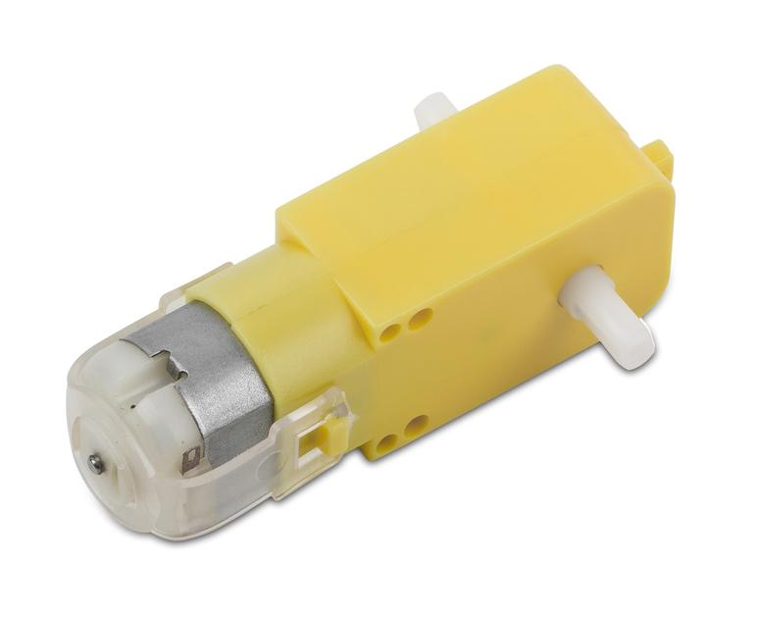
HARDWARE REQUIREMENTS
DC MOTOR :
A DC motor is any of a class of rotary electrical motors that converts direct current electrical energy into mechanical energy.
All types of DC motors have some internal mechanism, either electromechanical or electronic, to periodically change the direction of current in part of the motor.
DC motors were the first form of motor widely used, as they could be powered from existing direct-current lighting power distribution systems.
Larger DC motors are currently used in propulsion of electric vehicles, elevator and hoists, and in drives for steel rolling mills.

Slide 12
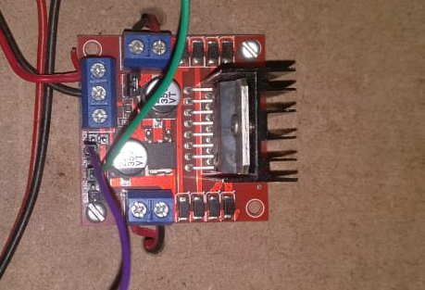
HARDWARE REQUIREMENTS
MOTOR DRIVER(L298N):
L298N Motor Driver Module is a high power motor driver module for driving DC and Stepper Motors.
This module consists of an L298 motor driver IC and a 78M05 5V regulator.
L298N Module can control 2 DC motors with directional and speed control.
The L298N Motor Driver module consists of an L298 Motor Driver IC, 78M05 Voltage Regulator, resistors, capacitor, Power LED, 5V jumper in an integrated circuit.
ENA & ENB pins are speed control pins for Motor A and Motor B while IN1& IN2 and IN3 & IN4 are direction control pins for Motor A and Motor B.

Slide 13
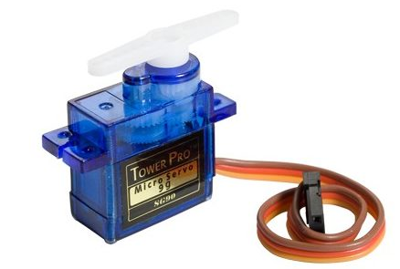
HARDWARE REQUIREMENTS
SERVO MOTOR(SG90):
Servo can rotate approximately 180 degrees.
It acts as the pivot for the arm enabling it to rotate and executing the movement of the arm and elbow.
Servos are controlled by sending an electrical pulse of variable width, or pulse width modulation (PWM), through the control wire.

Slide 14
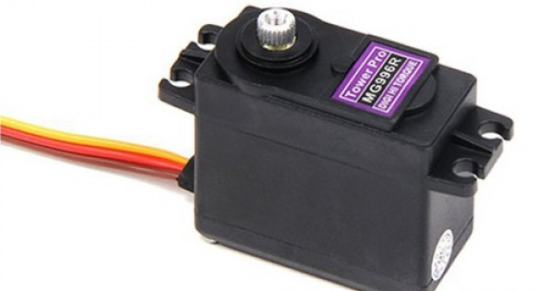
HARDWARE REQUIREMENTS
SERVO MOTOR(MG996r):
The MG996r is a metal gear servo motor with a maximum stall torque of 11 kg/cm.
Servo motor rotates from 0 to 180 degree based on the duty cycle of the PWM wave supplied to its signal pin.
The MG996R is essentially an upgraded version of the famous MG995 servo, and features upgraded shock- roofing and a redesigned PCB and IC control system that make it much more accurate than its predecessor.
The gearing and motor have also been upgraded to improve dead bandwidth and centering.

Slide 15
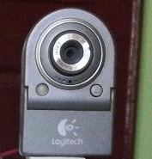
HARDWARE REQUIREMENTS
CAMERA (LOGITECH QUICKCAM NOTEBOOK DELUXE ):
It can only support video at 640 x 480 pixels.
Cameras have various mechanisms to control how the light falls onto the light-sensitive surface.
Lenses focus the light entering the camera, the size of the aperture can be widened or narrowed to let more or less light into the camera, and a shutter mechanism determines the amount of time the photo-sensitive surface is exposed to the light.

Slide 16
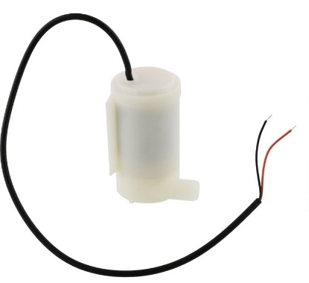
HARDWARE REQUIREMENTS
DC SUBMERSIBLE WATER PUMP:
The pump is a geared down DC motor with lot of torque.
The DC motor is contained in a sealed case attached to the impeller and powers it through a simple gear drive.
This pressure generated thereby pushes the water from one end to another.
Its 12v DC pump that supports upto 200 to 300mA current having temperature resistance up to 40 degree celsius.

Slide 17
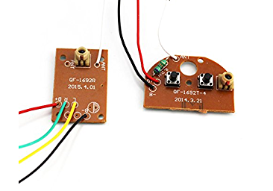
HARDWARE REQUIREMENTS
RF TRANSMITTER AND RECEIVER:
RF module operates at Radio Frequency whose frequency range varies between 20 kHz & 300 GHz.
The digital data is represented as variations in the amplitude of carrier wave. This types of modulation is an Amplitude Shift Keying (ASK) .
The transmitter/receiver (Tx/Rx) pair operates at a frequency of 27 MHz.
The transmission occurs at the rate of 1 Kbps – 10 Kbps.
The signal that has to be sent is kept HIGH and the other signal is LOW, this helps to send a signal to the receiver.

Slide 18
HARDWARE REQUIREMENTS
COLOR SENSOR (TCS3200):
A color sensor is a type of "photoelectric sensor" which emits light from a transmitter, and then detects the light reflected back from the detection object with a receiver.
A color sensor can detect the received light intensity for red, blue and green respectively, making it possible to determine the color of the target object.
A light source to illuminate the material surface, a surface whose color has to be detected and the receivers which can measure the reflected wavelengths.
Color sensors contain a white light emitter to illuminate the surface.
Three filters with wavelength sensitivities at 580nm, 540nm, 450nm to measure the wavelengths of red, green and blue colors respectively.
Here it is used in order to distinguish between the tables and denotes the destination where the robot has to reach.

Slide 19
SOFTWARE REQUIREMENTS
PYTHON IDE:
Python is an interpreted, object-oriented, high-level programming language with dynamic semantics.
Python supports modules and packages, which encourages program modularity and code reuse.
This software helps to execute the gesture recognition part in the computer and extrapolate the output
PYCHARM:
PyCharm is a hybrid-platform developed by JetBrains as an IDE for Python.
It supports two versions, namely v2.x and v3.x. PyCharm is compatible on Windows, Linux, or Mac OS.
It is capable of integrating with various tools such as IPython, Django, and Pytest.
This software using python, helps construct a program that involve gesture recognition using certain exclusive library files.

Slide 20
SOFTWARE REQUIREMENTS
ARDUINO IDE:
The Arduino Integrated Development Environment contains a text editor for writing code, a message area, a text console, a toolbar with buttons for common functions and a series of menus.
It connects to the Arduino and Genuino hardware to upload programs and communicate with them.
Programs written using Arduino Software (IDE) are called sketches and are saved using .ino format.
Arduino IDE helps support evaluation and dynamic execution of the programs.
The prototype uses this environment to helps construct programs for each individual hardware modules used to build this working model.

Slide 21
SOFTWARE REQUIREMENTS
OPENCV:
OpenCV (Open Source Computer Vision Library) is an open source computer vision and machine learning software library.
OpenCV was built to provide a common infrastructure for computer vision applications and to accelerate the use of machine perception in the commercial products.
It has more than 2500 optimized algorithms, which includes a comprehensive set of both classic and state-of-the-art computer vision and machine learning algorithms.
Some of the key features used in this prototype includes:
Hand detection: The camera captures the hand in a limited dimension frame.
Blur: A blur is then induced into the frame.
Grayscale: The given frame is then converted into a grayscale
Bordering, masking and blackening the frame: Subsequently after the above steps are completed, the frame only contains the gesture which is white setting the background black.
Contour Marking: The captured frame which comprises the gesture outlined by a green line.
Convex and Hull: Dots separate the fingers in between which subtend acute angles.
Threshold: the environment and surrounding lighting conditions as well as the brightness is adjusted.

Slide 22
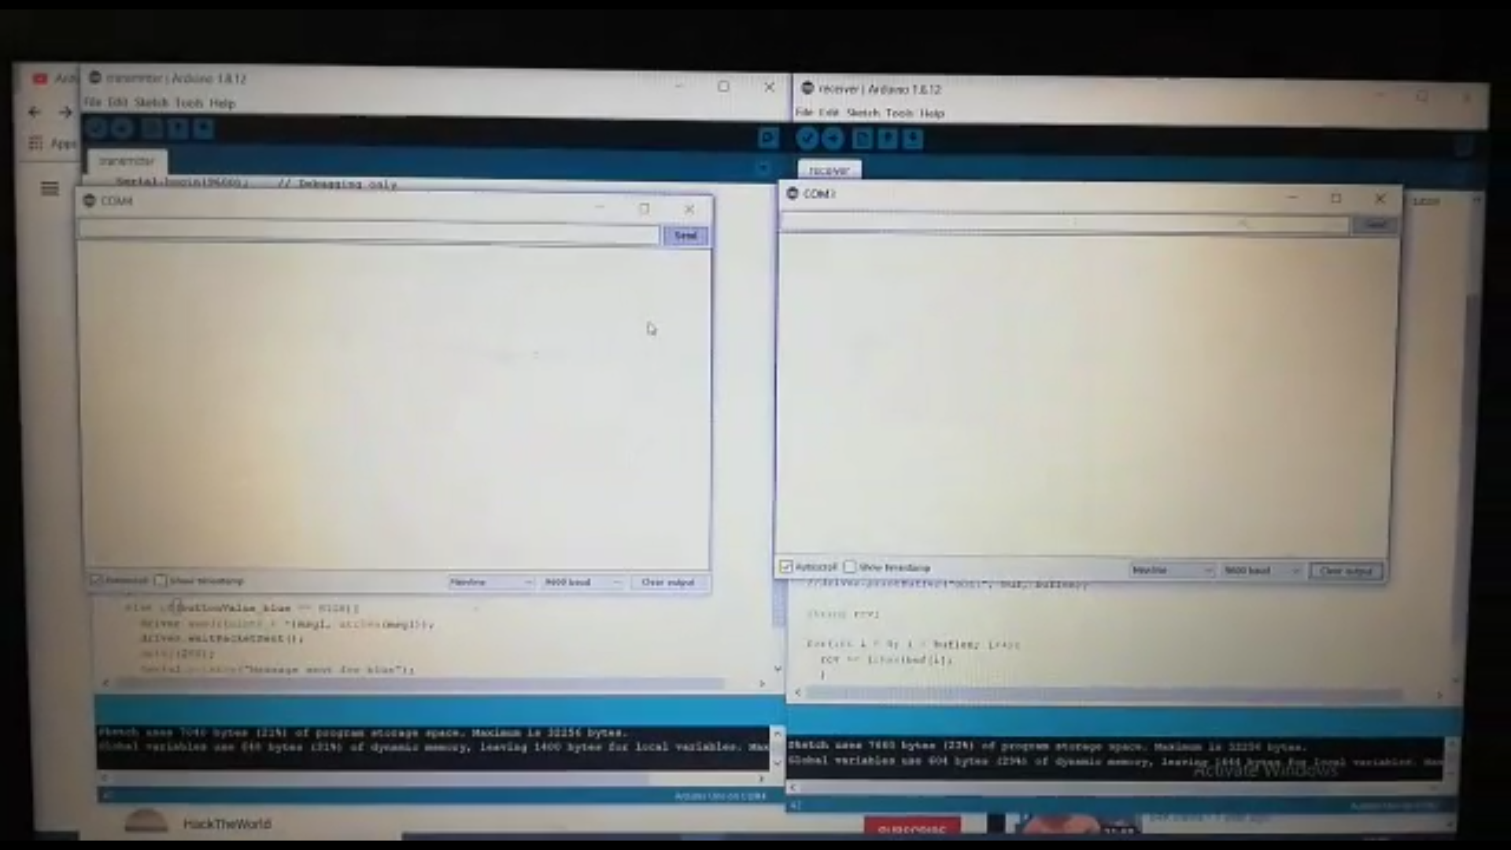
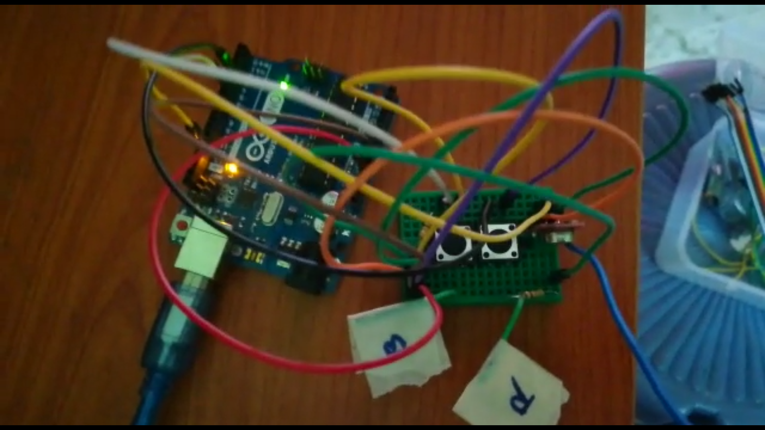
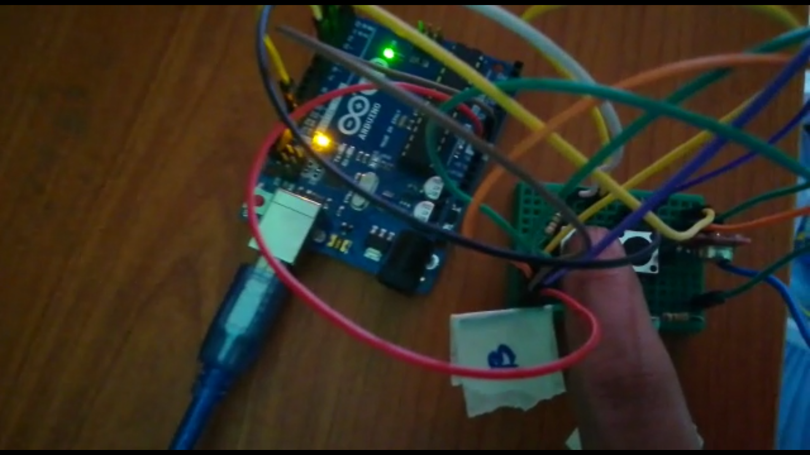
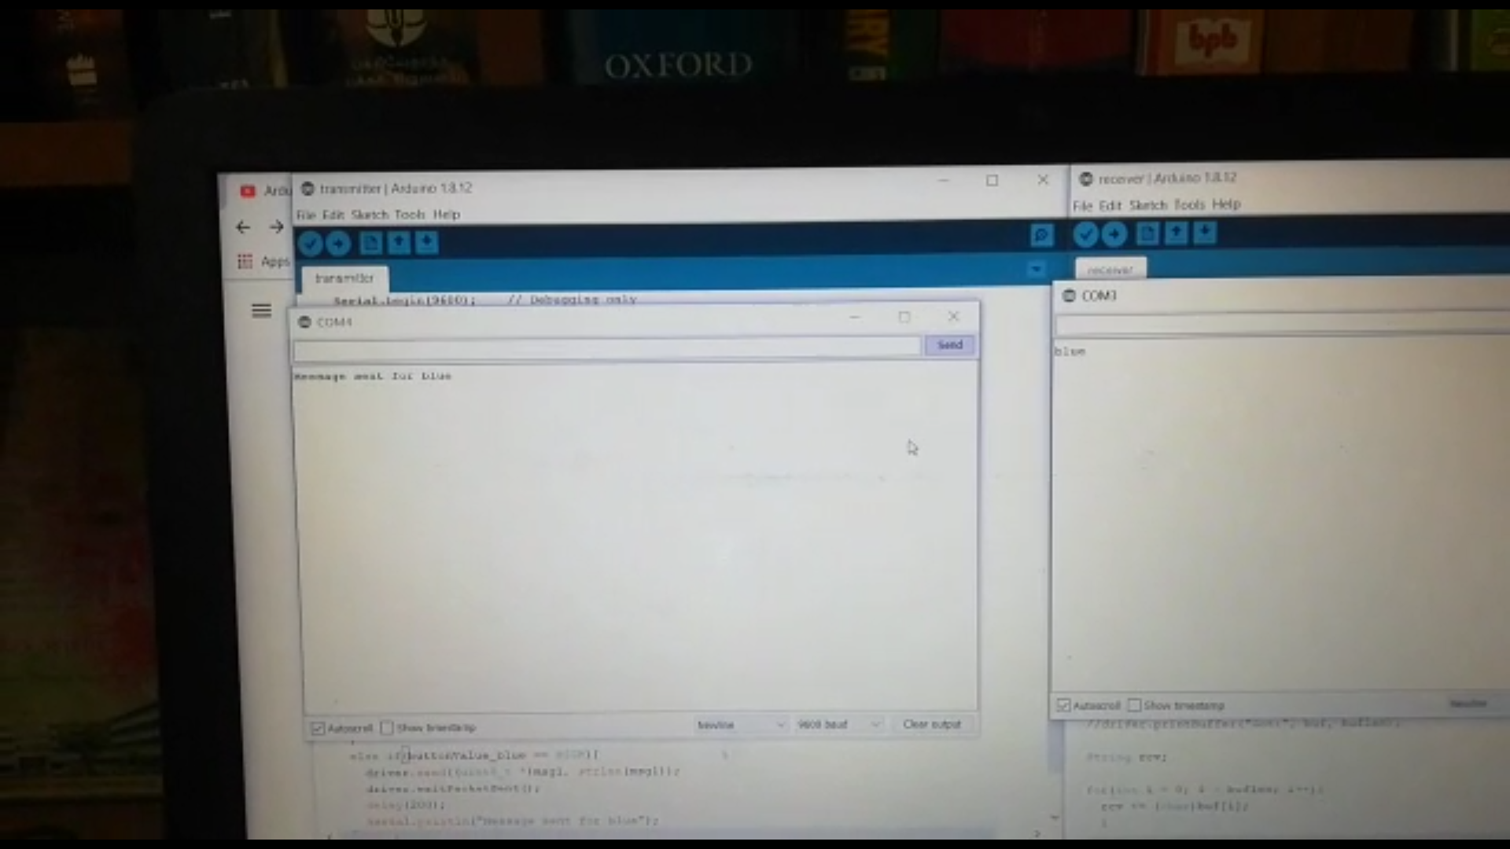
WORK DONE
Awaiting position of destination table
The buttons denote the table position namely ‘B’ for table Blue and ‘R’ for table Red
Blue switch is pressed indicating destination towards blue table
The robot receives the command to set destination towards blue table

Slide 23
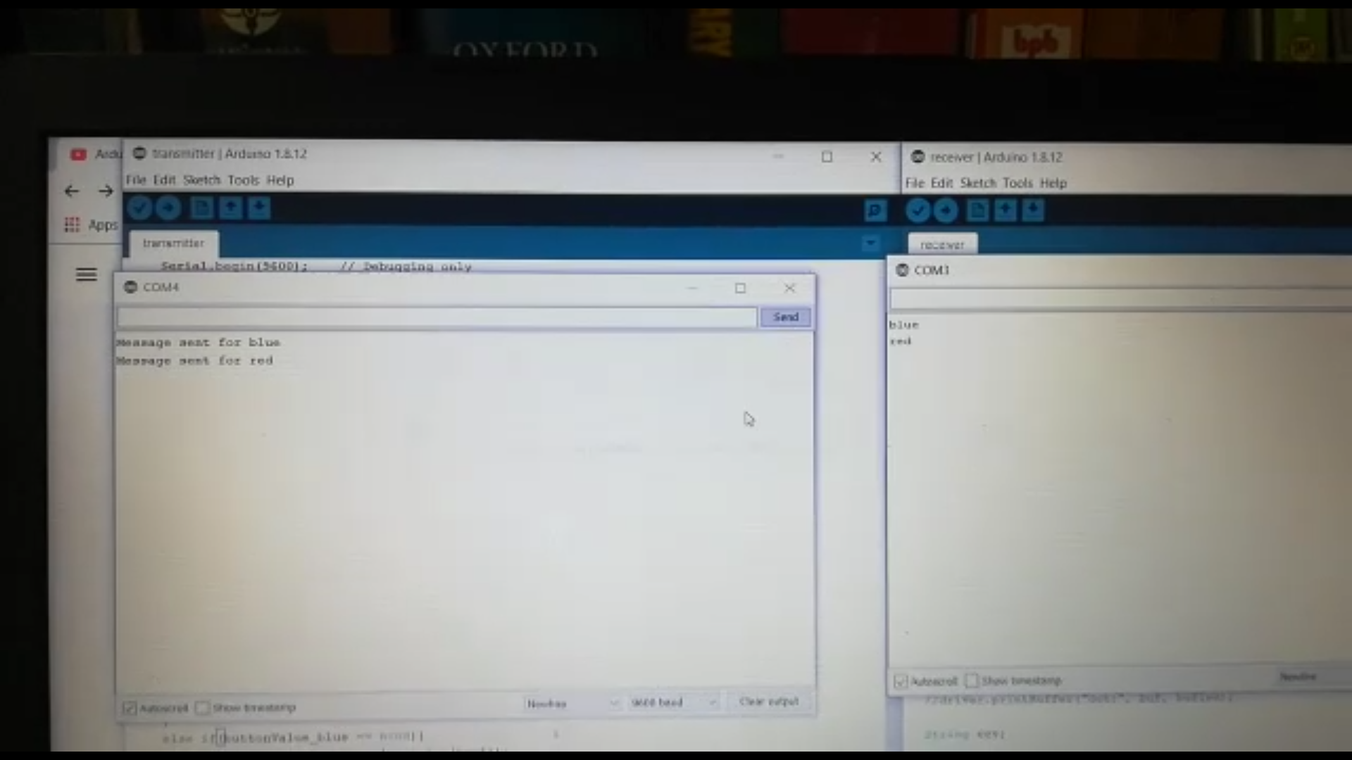
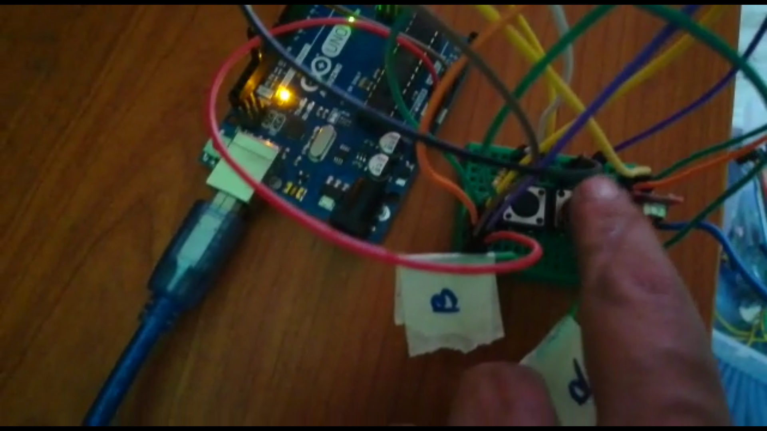
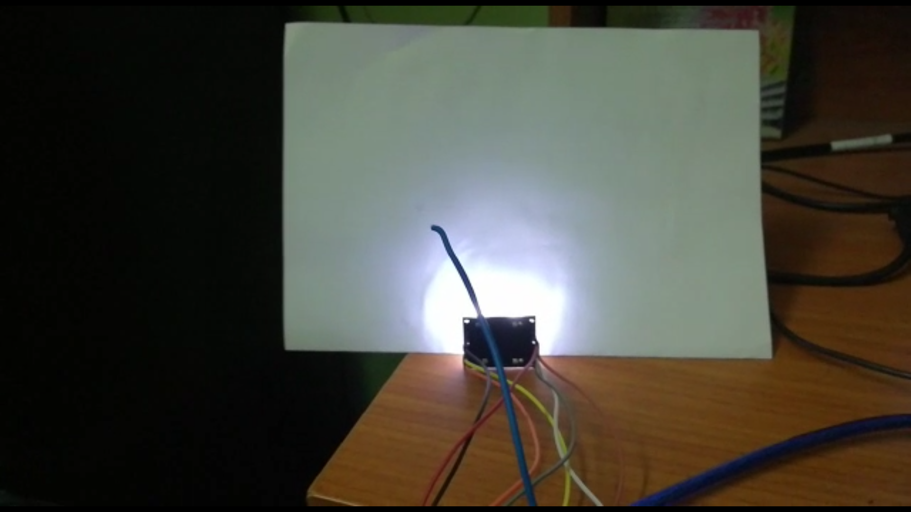
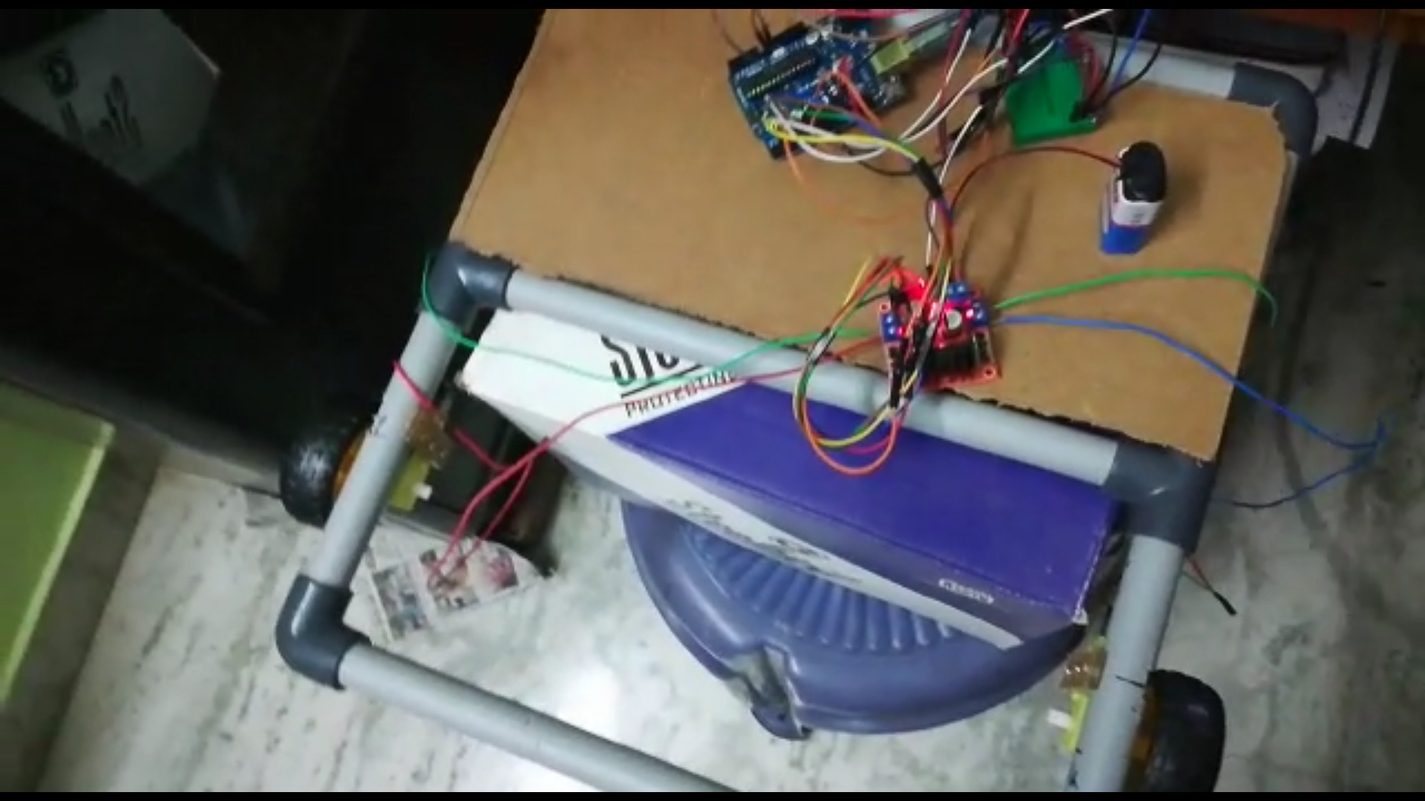
Similarly the Red table is configured
The color sensor senses the color of the path
The wheels do not rotate and is stationed at the origin

Slide 24
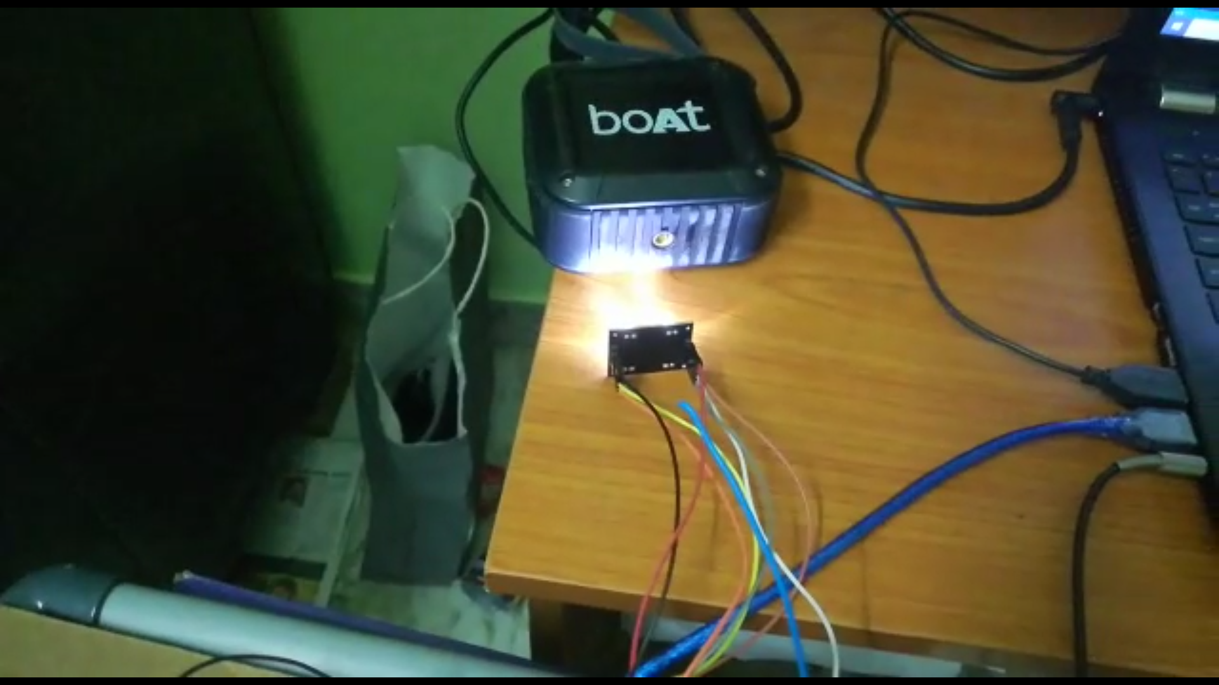
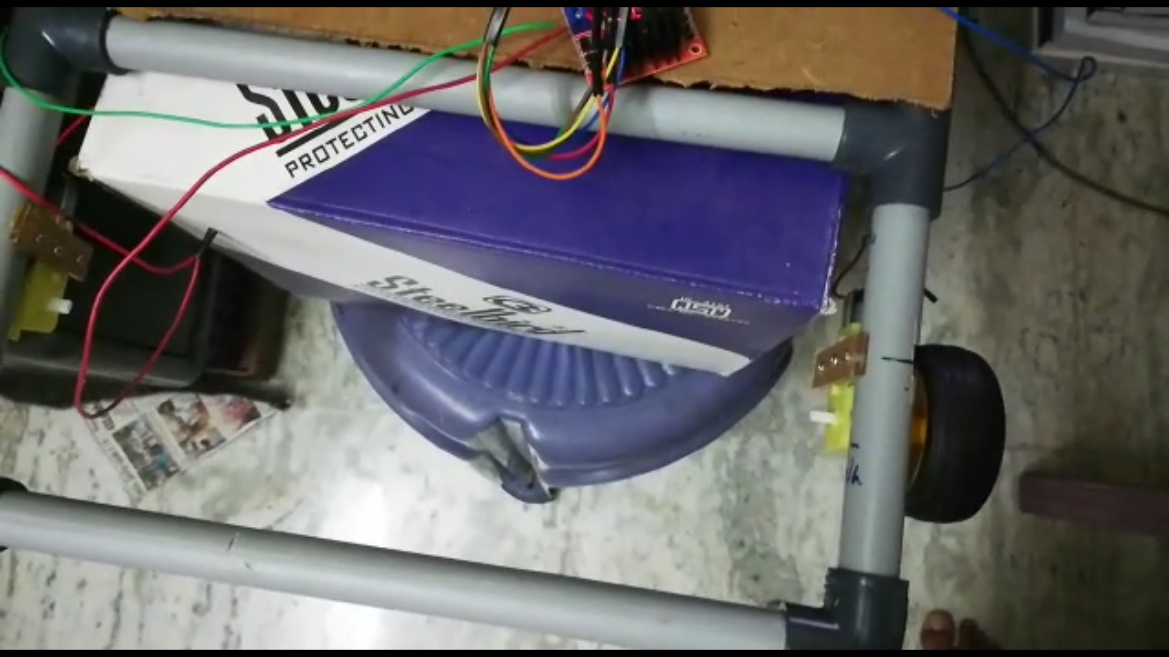
As soon as the color sensor senses the blue path the wheels start to rotate in the forward motion towards the table

Slide 25
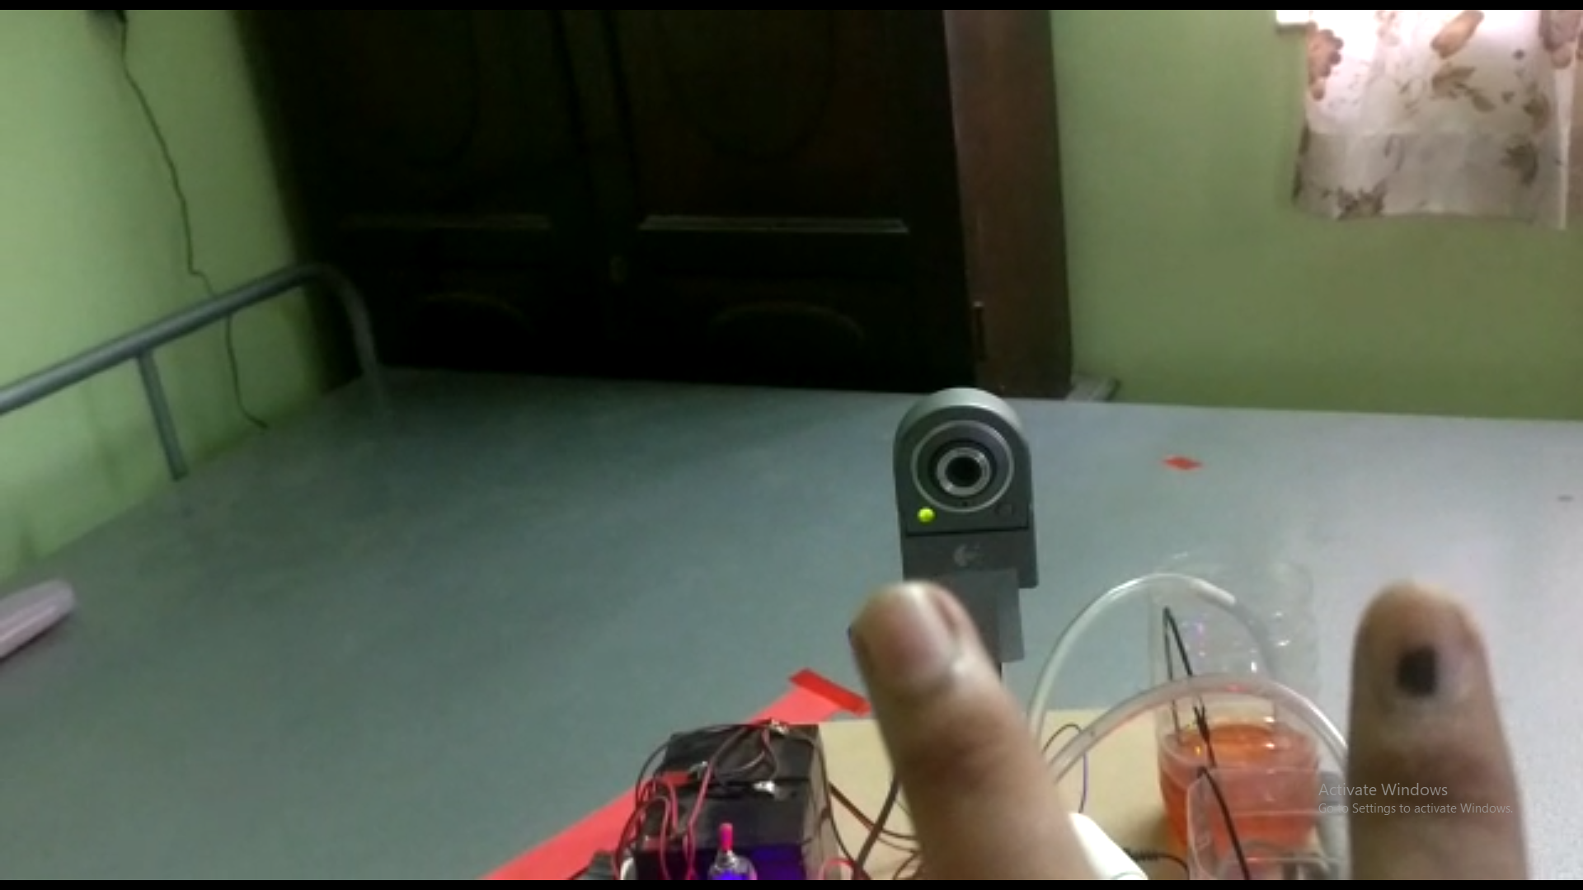
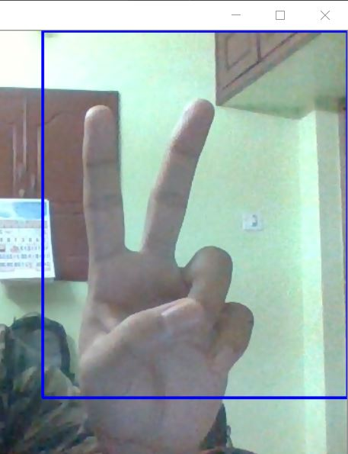
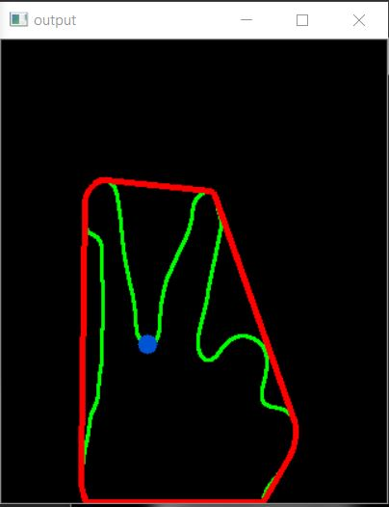
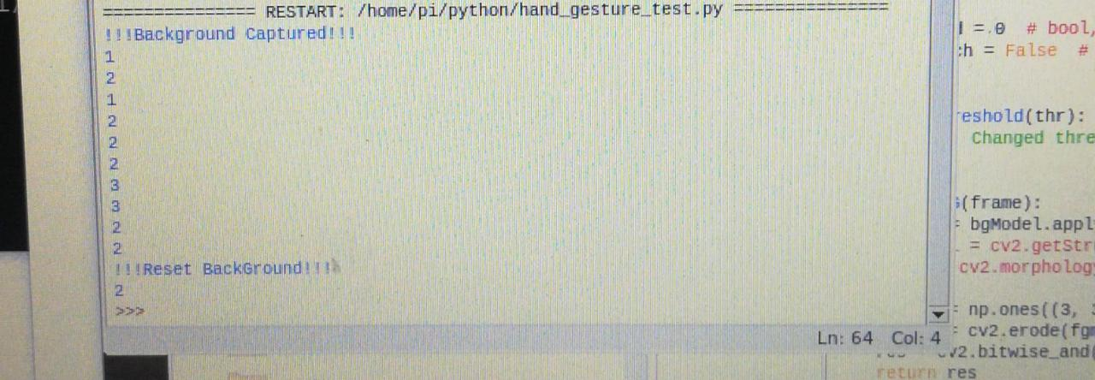
The customer shows the gesture to the camera
The gesture is captured and interpreted to a number
The number is processed and sent to the dispenser

Slide 26
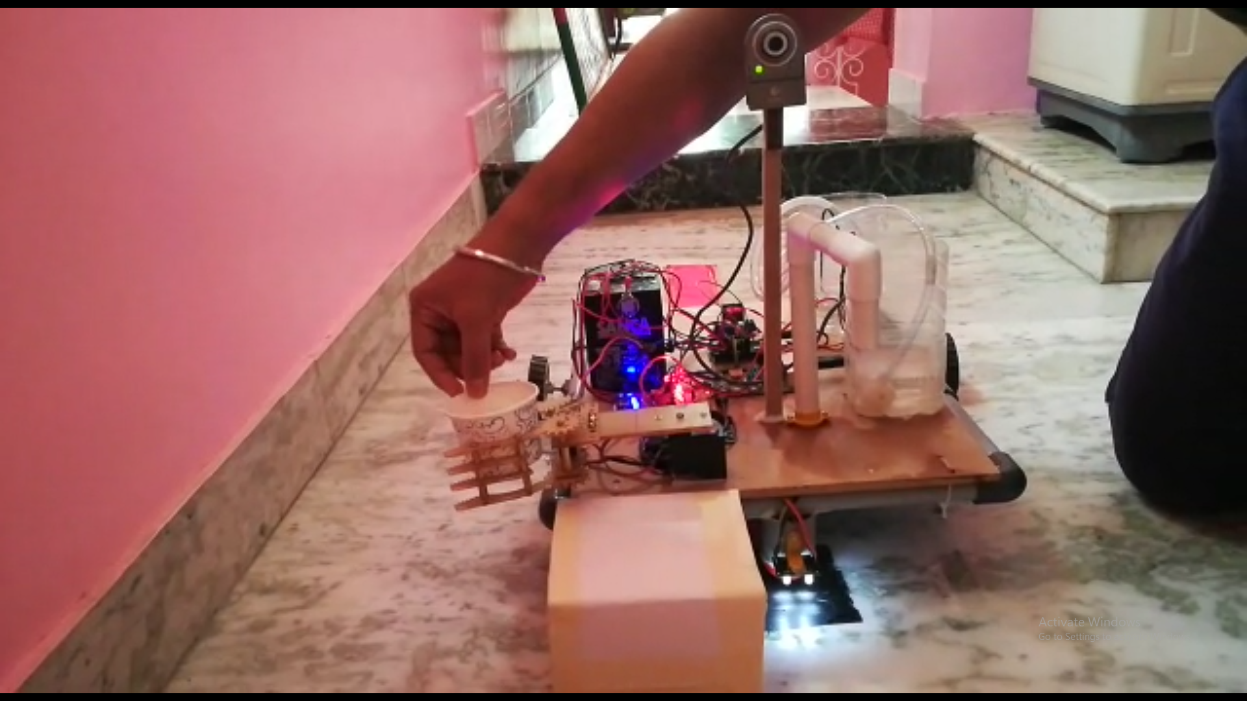
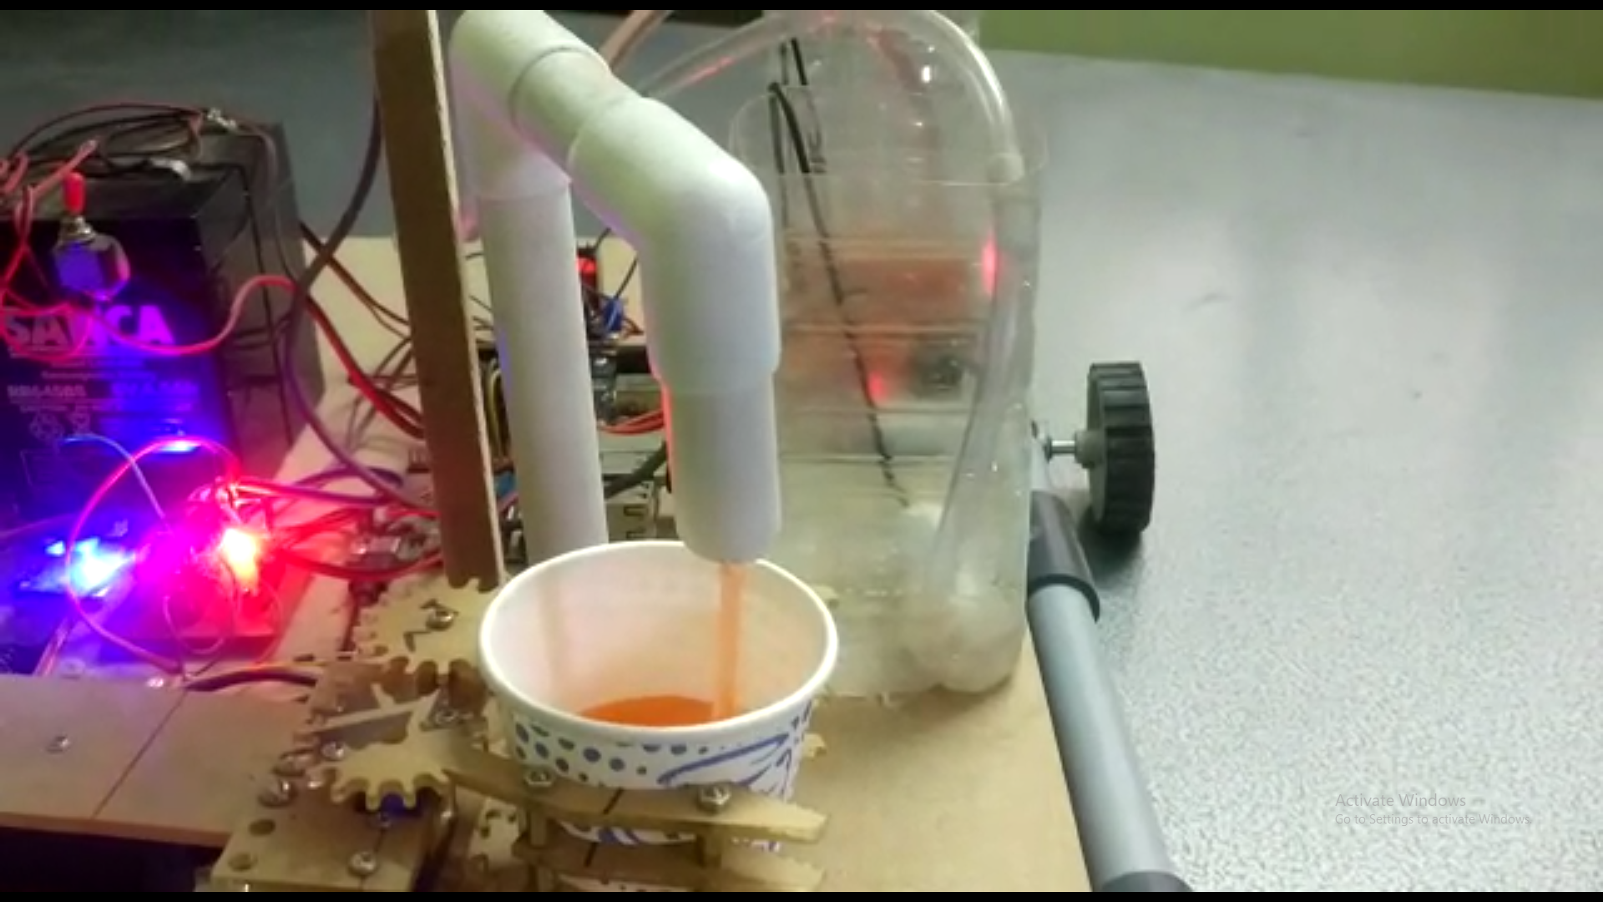
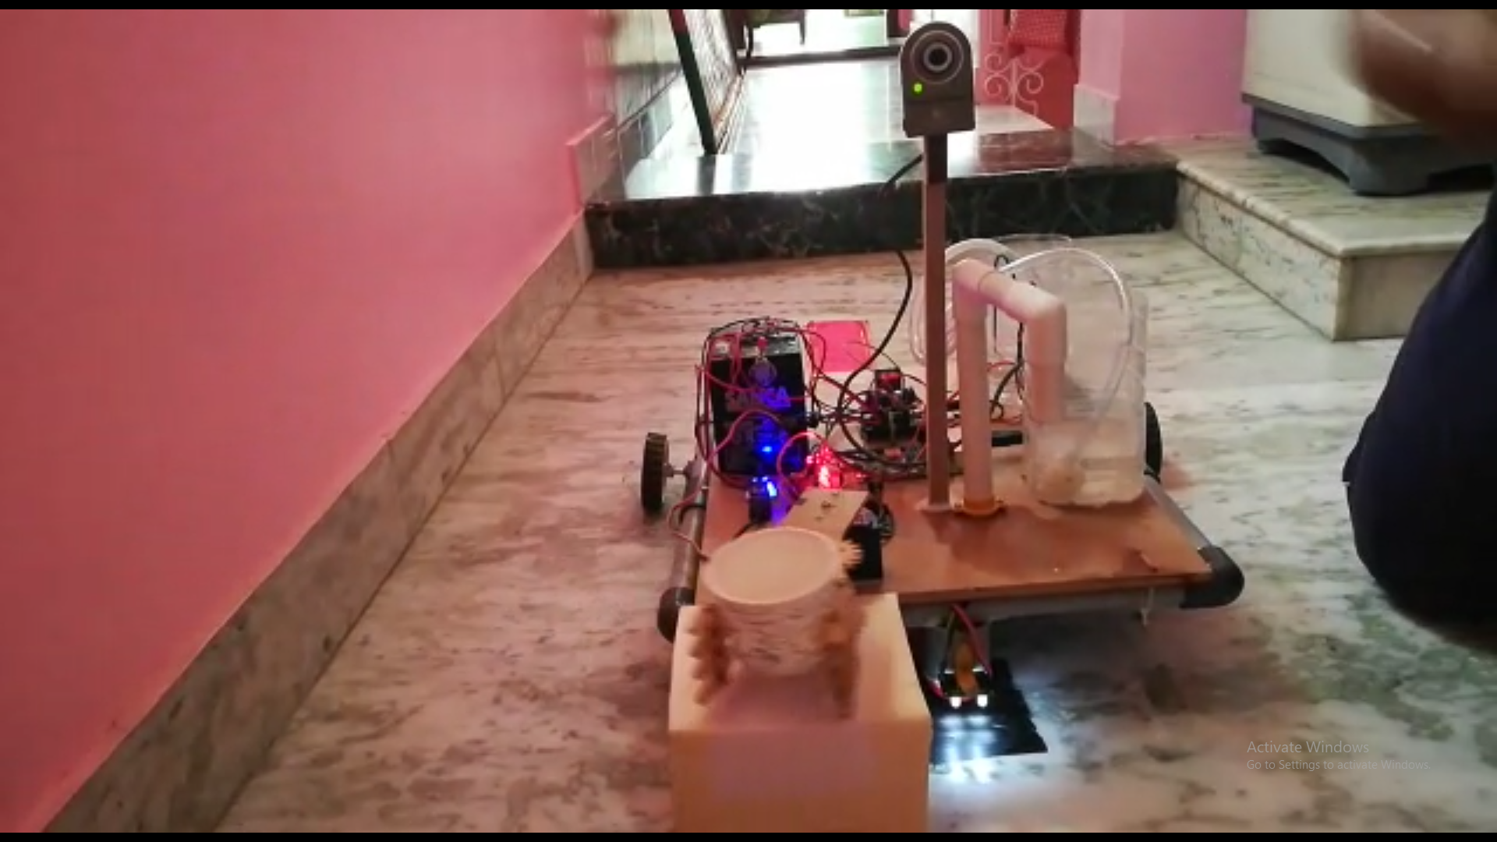
The arm receives the cup from the customer
The dispenser contains a DC submersible pump that pushes the fluid into the cup from the storage unit
The arm then serves the cup containing the drink on a tray

Slide 27
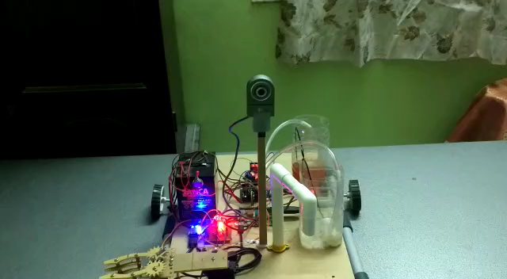
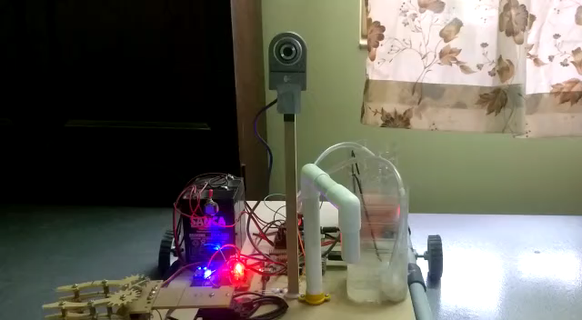
DEMONSTRATION
PROTOTYPE PHASE 1
Path Blue – Gesture 1
Path Red – Gesture 2

Slide 28
CONCLUSION
Our project comprehends to the needs of the customer being cost efficient as well as environment friendly to the investor.
Moreover it is hassle free making it easy to maintain and help by avoiding human to human contact that conserves personal and communal hygiene.
It can be used in placed such as cafeterias, stalls, hospitals and at our home.
Being a Service-Bot, they can handle higher workloads, and are no less entertaining to watch. Considering the consistent quality and throughput, robot cafes are definitely a technology breakthrough.
Further improvements can be made from this existing model depending on the investor’s need.

Slide 29
REFERENCES
Peristaltic pumps - Jordan M. Berg and Tim Dallas
Smart Food Serving Robot In Restaurant – by S.Jeyavinotha, D J Nibin, J V Ajesh, N V Ajin
Hand gesture recognition using python and opencv – by Sadaival Singh
Face Tracking OpenCV, Python, & Arduino – by Liz from learn robotics
Training a Neural Network to Detect Gestures with OpenCV in Python – by Breiner Heintz
Fingers-Detection-using-OpenCV-and-Python – by Izane
Design and fabrication of pick and place robotic - Dr.T. Sunil kumar, K.sarath, Sd.Famil, A.V.S.Bhagyesh and Sk.Althaf
Waving real-hand gestures recorded by wearable motion sensors to a virtual car and driver in a mixed-reality parking game - Bannach, D., Amft, O., Kunze, K.S., Heinz, E.A. Tröster, G., and Lukowicz, P.
Developing a multiple-angle hand-gesture-recognition system for human-machine interactions - Chen, Y.T. and Tseng, K.T.

Slide 30
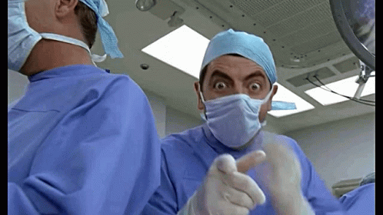
THANK YOU (PS- STAY HOME , STAY SAFE)

